Slide 1
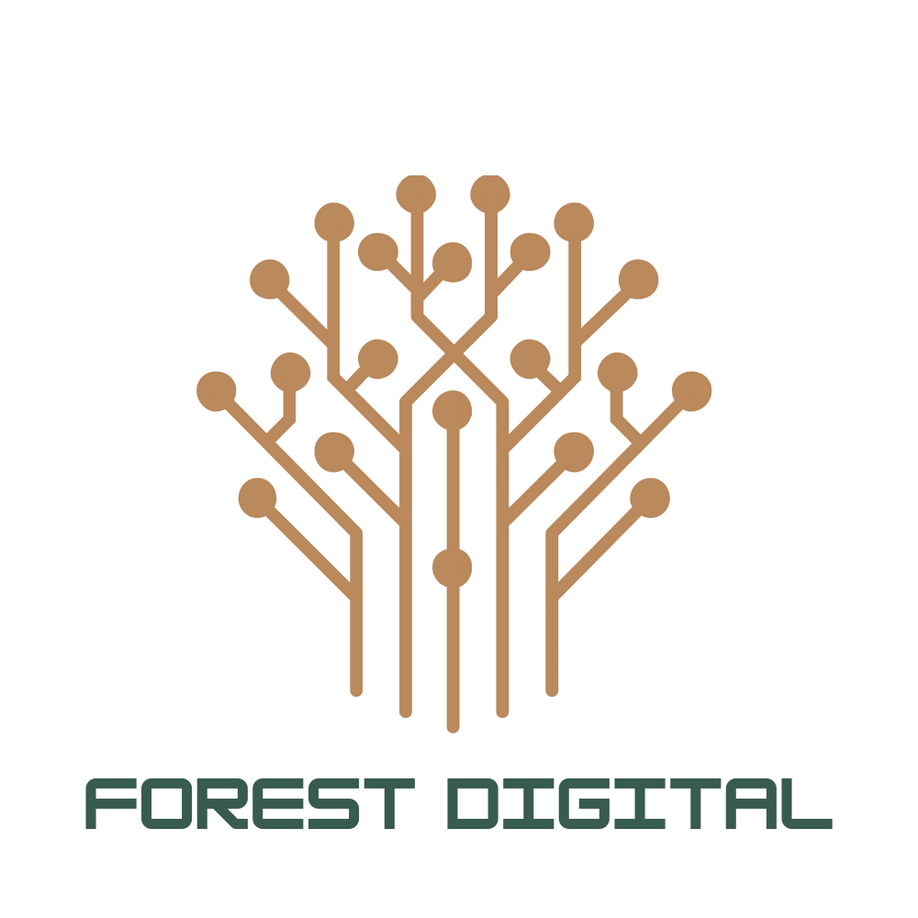
FOREST DIGITAL · SALESFORCE & AI FOR O2
FRESH AIR FOR YOUR SALESFORCE JOURNEY
10+
40+
50+
Years on Salesforce
Certifications
Salesforce projects
Advisory & Strategy
Cost Optimization
Managed Services
Product Development
Agentforce & Analytics
Roadmaps, platform evaluation, AI-readiness assessment.
Licenses, org consolidation, lower TCO without losing capability.
Hyper-care, break-fix and enhancement — flexible senior PODs.
LWC, Experience Cloud, integrations & AppExchange builds.
Agentforce quickstarts for Sales & Service, Data Cloud, AI analytics.
DEEP AI EXPERTISE
Agentforce agents grounded in your CRM and Data Cloud. External MCP servers within Salesforce or Salesforce MCP servers to 3rd party systems. Agentic development with our forward deployed engineers. And we've built our own agentic AI product, DAICISION . We don't just implement AI, we build and run it.
WHY IT FITS TELCO
Subscriber lifecycle, service operations and connected-device insight - the patterns we already run for subscription and IoT-heavy industries.
Forest Digital — we provide fresh air to your digital journey.
SALESFORCE · AGENTFORCE · DAICISION

