Slide 2
ABOUT US

Slide 3
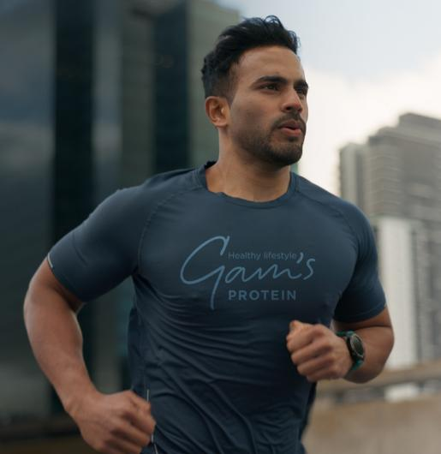
OUR MISSION
ANJ Distribution’s mission is to widely provide protein-enhanced snacks and food supplements that support stamina and promote an active, health-conscious lifestyle, using pure ingredients with nothing artificial.
We assist Slovak producers in expanding their protein-enhanced product lines by placing their products on shelves around the globe.

Slide 4
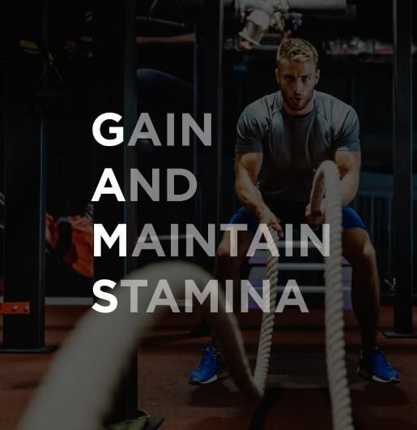

OUR BRAND
WE ARE PROUD OWNERS OF THE BRAND
"GAIN AND MAINTAIN STAMINA" speaks to ENERGY, STRENGTH, STAYING POWER, ENDURANCE, and VITALITY, catering to active, health-conscious individuals as well as those aspiring to enhance their performance and well-being.
Gam‘s delivers irresistibly tasty protein snacks and dietary supplements, crafted to empower a wide range of people in embracing an active and healthy lifestyle.

Slide 5
THE STORY OF GAM’S
These products were designed not only for active individuals but also for those looking to manage their weight and incorporate more activity into their daily lives. The founders believed that protein-enhanced foods are not just for athletes, but can also be beneficial in everyday, challenging life situations to help Gain And Maintain Stamina.
In 2018, they founded a small business and introduced the new consumer brand, GAM’s, promoting and selling protein bars to new consumers, fitness centers, and sports clubs.
By 2021, this initiative had evolved into Gam’s, a successful company with a well-known e-commerce platform serving the Czech Republic and Slovakia.
In 2024, ANJ-distribution, a young and dynamic distribution company recognized for its professional processes and experience in the food industry, took over (CEO – Robert Palka, CTO – Jozef Štefaňák). Company brings direct production capabilities for protein-based products, enhancing expertise in product development, production, sales, and marketing.
This transition is set to elevate the Gam’s brand to new strategic heights, expanding its consumer base, market reach, and geographical presence.
After facing personal health challenges related to a close family member’s eating disorder, the founders decided to dedicate their lives to promoting an active lifestyle and balanced nutrition. A reputable nutrition specialist recommended incorporating protein bars into the diet as part of the treatment, inspiring the founders to explore the potential of these products in supporting overall stamina and offering a guilt-free alternative to traditional sweet treats.
Fueled by enthusiasm, they began collaborating with a local food producer, refining their ideas into tangible product concepts. Within a year, they had jointly developed the first exceptionally tasty and healthy protein bar recipes, ready for production. While many protein bars on the market were loaded with sugar, soy, and whey, their ambition was to create the cleanest possible alternatives.

Slide 6
OUR TEAM
OWNERS
Co-Owner and CEO
Robert Palka
Co-Owner and CTO
Jozef Štefaňák
With over 20 years of experience in trading companies, I have honed my expertise in managing both domestic and international trade, as well as overseeing operations in the food manufacturing sector.
Throughout my career, I’ve developed a deep understanding of local and global markets, which I continuously apply to meet the needs of our satisfied clients.
20+ Years of experience in trading and food manufacturing
Expetise in domestic and international markets
I bring several years of experience managing production and technical departments in food companies, specializing in recipe development and supply chain management.
My hands-on involvement in international trade has provided me with invaluable insights, which I leverage to deliver the best solutions for our customers.
Extensive experience in food production and supply chain managment
Proven succes in both domestic and international markets

Slide 7




OUT TEAM OF EXPERTS
Gabriela Klčová
Adriána Slobodníková
Iveta Esseová
Anna Buzinkay
Business development manager & export
Country manager SK/CZ
R&D Manager
Marketing Lead

Slide 8
INDUSTRIES WE SERVE

Slide 9

INDUSTRIES WE SERVE
WHO IS CONSUMING OUR PRODUCTS?
CORE TARGET
ACTIVE, HEALTH-CONSCIOUS INVIDUALS
LIFESTYLE:
Regularly engages in physical activities such as running, cycling, yoga, gym workouts, and hiking
Prioritizes mental and physical well-being
Interested in holistic health, including diet, exercise, and mental health
PURCHASING BEHAVIOR:
Prefers convenient, healthy snack options that complement their active lifestyle
Looks for products with specific health benefits, such as protein, collagen, and fiber
Willing to invest in premium fitness and health products

Slide 10
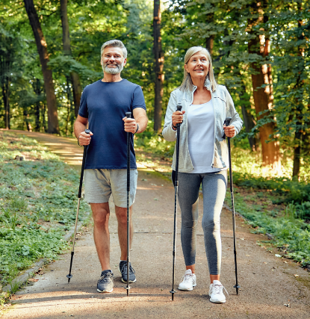
INDUSTRIES WE SERVE
WHO IS CONSUMING OUR PRODUCTS?
WIDER TARGET
ASPIRING ACTIVE, HEALT-CONSCIOUS INDIVIDUALS
LIFESTYLE:
Currently more sedentary or inactive but motivated to change
Interested in learning about and adopting healthier habits
May feel stressed or dissatisfied with current health and well-being
PURCHASING BEHAVIOR:
Interested in convenient, tasty, and healthy snack options that support their lifestyle changes
Prefers products that provide clear health benefits, such as protein, collagen, and fiber-enhanced snacks
Open to trying new products and services aimed at improving health
Values affordability and accessibility in health and fitness products

Slide 11
WHO ARE OUR CUSTOMERS?
Retailers, fitness centers or brand owners seeking an innovative external producer for protein-enhanced products and nutritional supplements will find in us a partner with a modern, relevant, and forward-thinking portfolio. Whether under the Gam’s or other brands in our portfolio, or your own private label, we provide solutions tailored to meet the specific needs of your consumers and markets.
End-consumers can typically buy protein-enhanced products from the following channels:
1. RETAIL STORES:
2. ONLINE PLATFORMS:
4. VENDING MACHINES:
Supermarkets & Grocery Stores: Most major grocery chains carry protein-enhanced snacks and supplements.
Health & Wellness Stores: Specialty stores that focus on health products.
Sports Nutrition Stores: Sport Shops, or independent nutrition stores often stock protein-enhanced products.
Pharmacies: Some pharmacies carry collagen, nutrition suplements, and
other functional foods
Brand’s E-commerce Website: Many brands sell directly to consumers through their websites.
Online Retailers: Platforms and other large e-commerce retailers.
Health & Wellness Online Stores: Sites specializing in fitness and nutrition products.
Many protein-enhanced bars or snacks are found in vending machines at gyms, airports, or office buildings.
5. SPECIALOZED EVENTS OR EXPOS:
Health or fitness expos, trade shows, and fitness competitions often feature booths where these products are sold.
By using these diverse channels, protein-enhanced products are accessible to a broad range of consumers in different countries and environments.
3. GYMS AND FITNESS CENTRES:
Protein snack and drinks are often sold at the counters of gyms or fitness studio.

Slide 12

GAM’S
HEALTHY LIFESTYLE
Gam’s portfolio provides a range of exceptionally tasty protein-enhanced snacks with collagen and fiber, alongside food supplements designed to support your stamina.
Our products help you easily achieve your active and health-conscious goals by delivering the nutrients you need for optimal performance and well-being, made from high-quality ingredients.
Our snacks and supplements are suitable for everyone, ensuring you can enjoy the benefits of a healthy lifestyle without compromise.
We also offer a product range for vegan consumers.

Slide 13
WHY PARTNER WITH US

Slide 14

WHY PARTNER
WITH US
PARTNERING WITH US MEANS
Acces to innovative, high-demand products
Tailored support and flexible production options
Competitive pricing and strong margins
Timely deliveries and exceptionals service
By partnering with us, you’re choosing a dynamic, market-driven company focused on your succes.

Slide 15
WHY COOPERATE WITH US IN DISTRIBUTING OUR BRANDS?
OUR QUALITY CERTIFICATION
At ANJ Distribution, we are committed to maintaining the highest quality standards across our product range. Our production sites hold key certifications such as HACCP and IFS, ensuring that every product meets strict safety and quality guidelines. Additionally, upon request, we can offer products with KOSHER, HALAL and other specific certifications, reflecting our dedication to serving diverse customer needs worldwide.
Innovative Product Portfolio
Flexibility & Customization
Strong Support System
Quality Assurance
Competitive Pricing & Profitability
Fast & Efficient Delivery
Brand Recognition

Slide 16
OUR DISTRIBUTION COUNTRIES
We proudly distribute our brands to 31 countries worldwide, delivering high-quality products. Each new market marks a milestone in our journey of growth and partnership. As we continue to expand, we are excited to bring our commitment to excellence and innovation to even more regions, reaching more consumers and connecting with new opportunities globally.
We distribute our brands to:
Argentina, Belgium, Bulgaria, Canary Islands, Chile, Costa Rica, Czech Republic, Denmark, England, Estonia, Finland, France, Greece, Hungary, Israel, Italy, Jordan, Kazakhstan, Kuwait, Latvia, Lithuania, Mauritius, Poland, Romania, Saudi Arabia, Singapore, Slovakia, South Korea, Sweden, United Arab Emirates, Vietnam

Slide 17

CONTACT US
CONTACT DETAILS
HEAD OFFICE
BILLING INFORMATION
A.N.J. DISTRIBUTION S.R.O.
Tel: +421 948 002 899
E-mail: sales@anj-distibution.com
A.N.J. DISTRIBUTION S.R.O.
Murgašova 738/27
927 01 Šaľa, Slovakia
A.N.J. DISTRIBUTION S.R.O.
Murgašova 738/27
927 01 Šaľa, Slovakia
IČO: 54 738 903, DIČ: 2121784390, IČ DPH: SK2121784390

